Slide 1
Fuzzy Logic
GA
Dr Samar Hesham
Department of Computer Science Faculty of Computers and Artificial Intelligence
Cairo University
Egypt
9/27/2022
1

Slide 2
Evolving Fuzzy Systems using Genetic Algorithms
We want to evolve a fuzzy rule system using a GA.
Things to consider:
What will be evolved (what parts of the fuzzy system)
How system elements are represented
Population initialization
Fitness evaluations
Operators used

Slide 3
What will we evolve?
Usually the rule base is evolved to get the best rules representing a dataset of a particular problem.
We can also evolve the membership functions used to find the best types (triangular, trapezoidal, …etc) and ranges.

Slide 4
Representing Fuzzy Rules
Each chromosome will represent a single rule set
Our system will use Mamdani-type fuzzy rules, for example:
if input_1 is not Low, and input_2 is High, then the output is Medium
if input_2 is Low, then the output is
High
but computers generally can’t handle this kind of input (yet)
Assuming each variable has three fuzzy sets; Low, Medium, High:
Let Low=1 Medium=2 High=3
The above two rules can be numerically represented as:
-1 3 2 and 0 1 3 (0 means “don’t care”)

Slide 5
Population Initialization
Random initialization of the population.
Rules are checked for feasibility.
Each rule must have a non-zero antecedent,
and a non-zero consequent.
Re-generate individuals to compensate for the infeasible chromosomes.

Slide 6
Fitness Evaluation
Percent correct and mean-square error are often used.
Additional components of fitness may include the number of rules (minimize).

Slide 7
Steps of Evolving a Fuzzy Rule System
Given a history of data (dataset), to a particular problem:
x1 | x2 | x3 | …… | xm | y
…. | …. | …. | …. | …. | ….
…. | …. | …. | …. | …. | ….
…. | …. | …. | …. | …. | ….
it is required to evolve a fuzzy system that will classify or predict y.

Slide 8
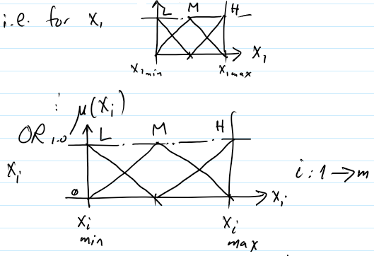
Evolving a Fuzzy Rule System
Step 1:
Get min and max of each Xi (column) in dataset => X_{i-min}, X_{i-max}
Step 2:
Design fuzzy sets (select them)

Slide 9
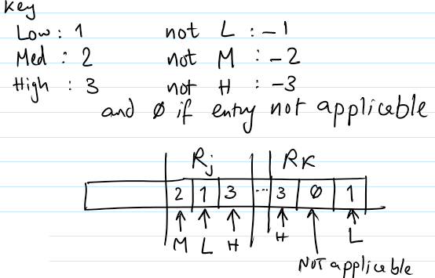
Evolving a Fuzzy Rule System
Step 3:
Design chromosomes composed of random set of fuzzy rules as follows:
Rj:
if x1=M and x2=L then y=H
Rk:
if x1=H then y=L

Slide 10
Evolving a Fuzzy Rule System
Step 3:
Note that number of rules in chromosome is variable => variable-length chromosome
chromosome 1:
chromosome 2:
R1 | R2 | R3 | R4
R5 | R6 | R7

Slide 11
Evolving a Fuzzy Rule System
Step 4:
Design of crossover operator
R1 | R2 | R3 | R4
R5 | R6 | R7
Random crossover point
Random crossover point
R1 | R6 | R7
R5 | R2 | R3 | R4

Slide 12
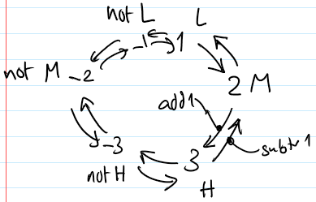
Evolving a Fuzzy Rule System
Step 5:
Design of mutation operator
According to random number r, for each entry in rule, either:
– Add 1 (r: 0- 0.33)
ex. L to M
– Subtract 1 (r: 0.34 – 0.66)
ex. H to M
– Negate (r: 0.67 - 1) ex. L to Not L

Slide 13
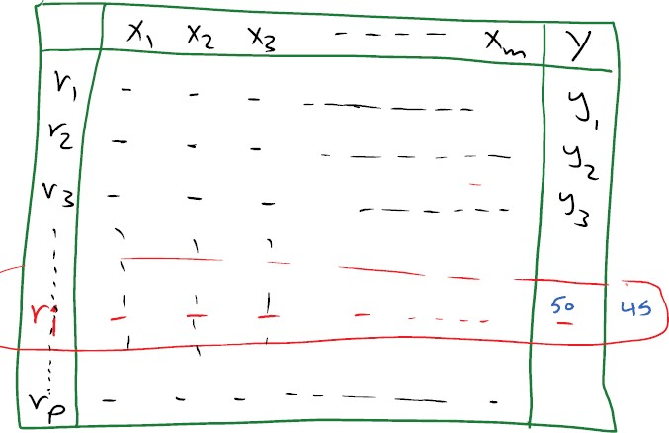
Evolving a Fuzzy Rule System
Step 6:
Fitness function
Run each fuzzy system (chromosome) as usual on dataset
Fitness_{i} = (number of correctly predicted rows)_{i}
Or Fitness_{i} = 1/MSE_{i} (mean square error)

Slide 14
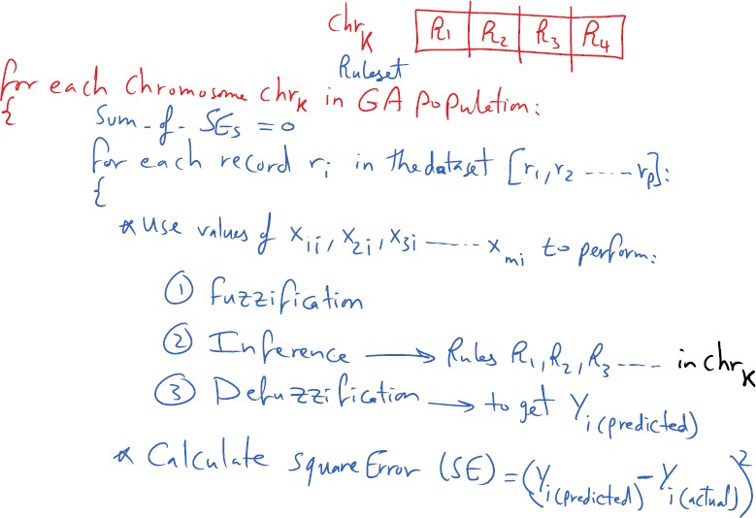
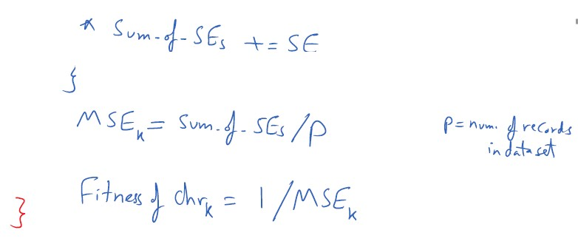
Calculate Fitness of Chromosome k: Mean Square Error

Slide 15
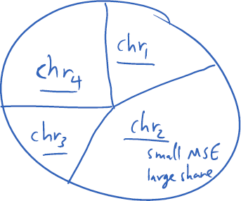
Evolving a Fuzzy Rule System
Step 7:
Selection Strategy: Roulette wheel selection
Step 8:
Replacement strategy: Elitism Strategy

